Slide 1




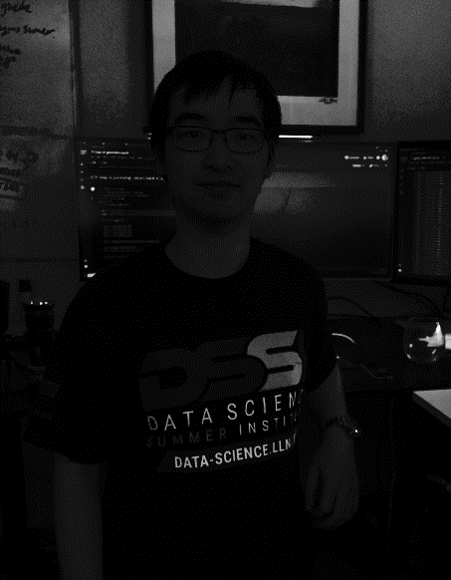
Team 6
Elyssa Hofgard
Andrei Rekesh
Ethan Ahlquist
Joe Hua

Slide 2
Presentation Outline
Problem statement/introduction
Star galaxy problem solutions
2 different CNN architectures
Asteroid problem solutions
Preprocessing
Traditional sliding window CNN approach
YOLO
Faster R-CNN
Conclusions and further steps

Slide 3
Problem Statement/Introduction

Slide 4
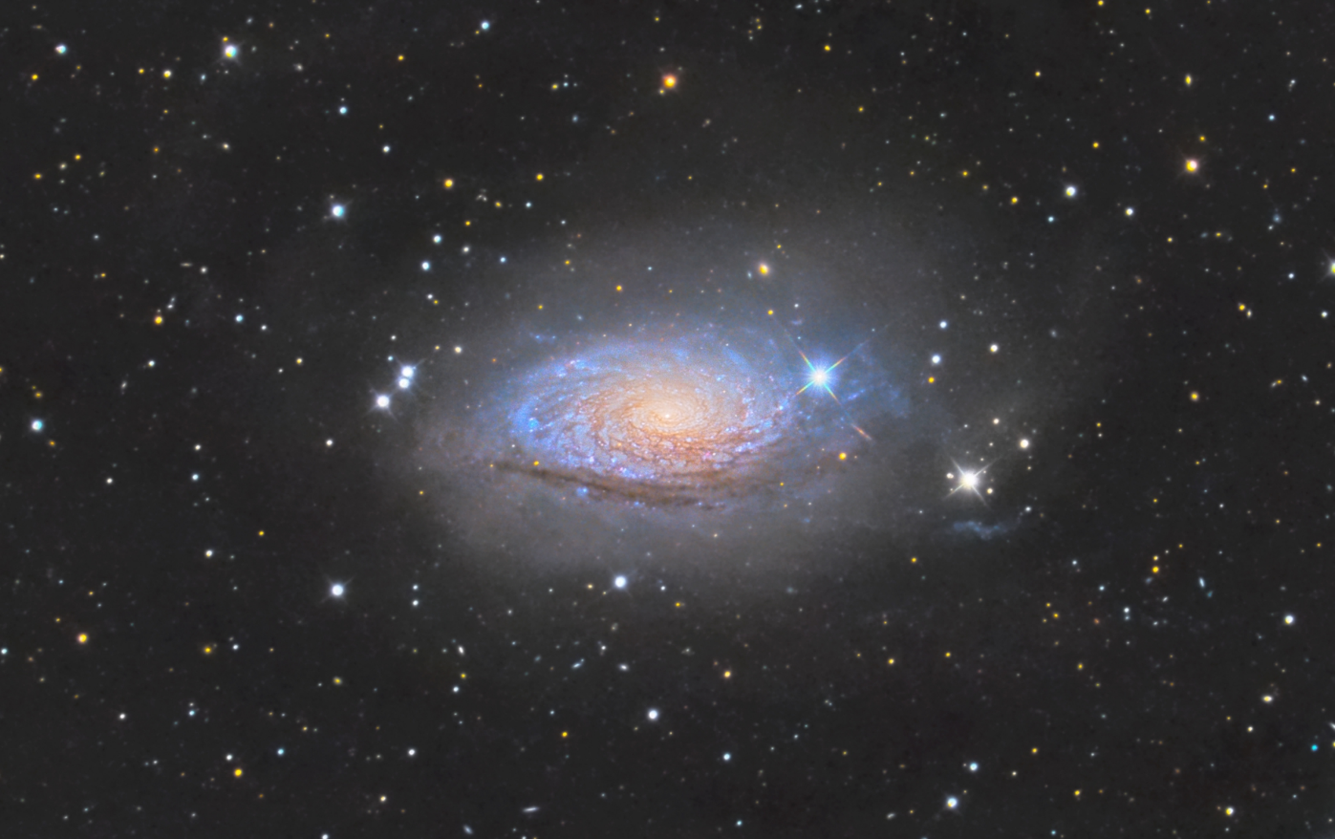
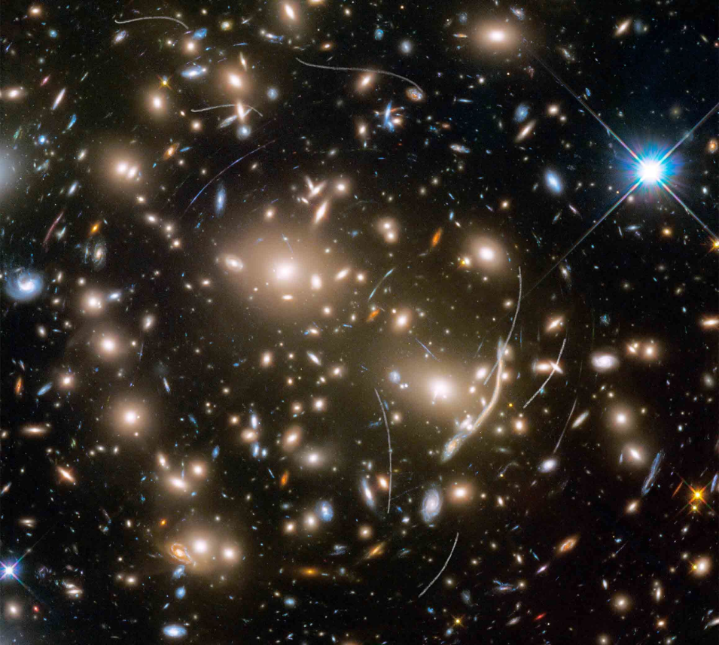
Problem Statement: Galaxy/Star Classification
Telescope images of distant celestial bodies are difficult to distinguish into stars and galaxies using the human eye.
Could a machine learning approach take better advantage of the information contained in all 8 channels of these images to classify them?

Slide 5
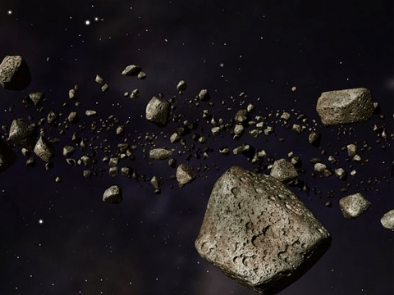
Problem Statement: Asteroid Detection
Can we use an object detection neural network to accurately identify asteroids among non-asteroid artifacts in grainy telescope images?

Slide 6
Star/Galaxy Problem

Slide 7
Solution #1
Notes:
Andrei

Slide 8
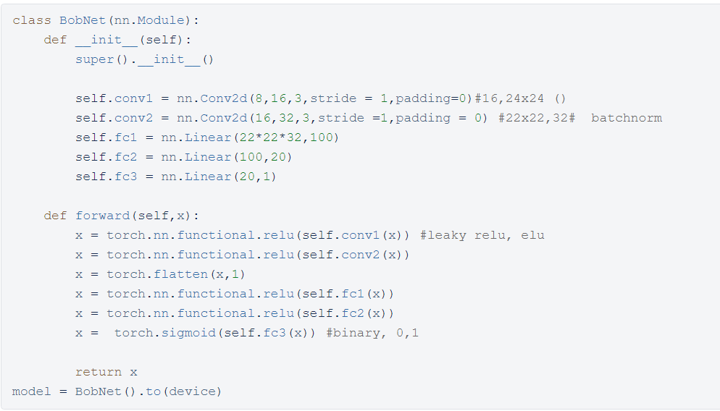
Normalization
Subtract background
Min/max normalization between 0 and 1
Basic CNN Architecture
2 Conv2D layers
3 linear layers with ReLu activation functions
Sigmoid output layer (for binary classification)
32 input nodes, 15899 batch size, Adam optimizer with lr .0002, train for 100 epochs

Slide 9
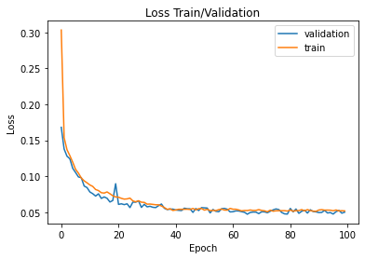
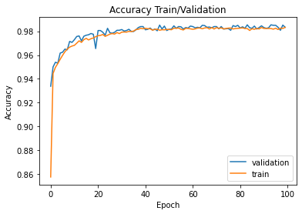
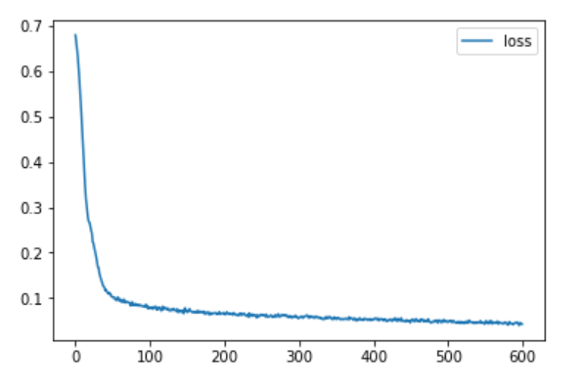
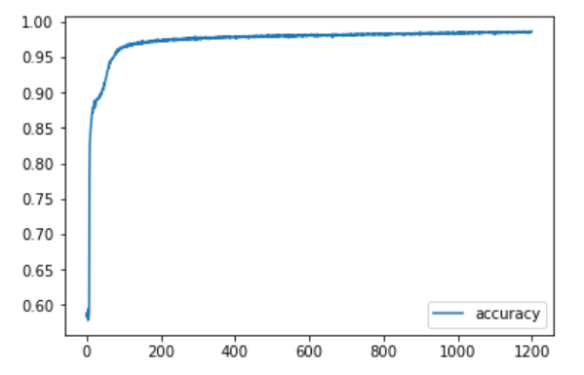
Model Evaluation
Stratified split into train (75%), validation (15%), test (10%), using binary cross entropy loss

Slide 10
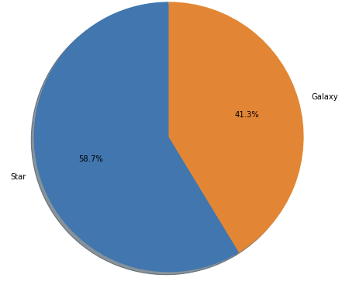
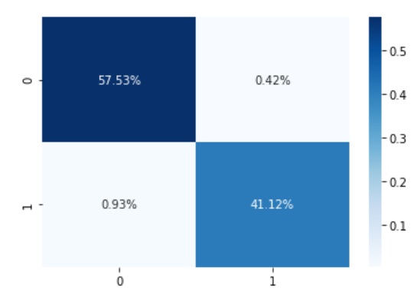
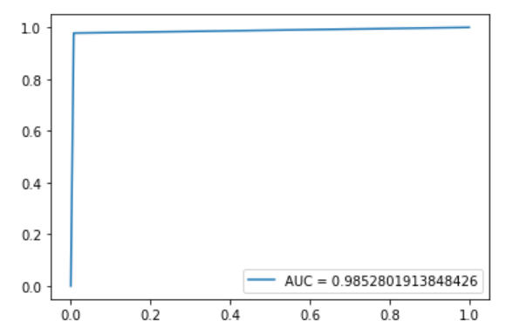
Star: 0, Galaxy: 1
AUC 0.985, test accuracy 0.987, f1 score 0.98

Slide 11
Solution #2
Notes:
Elyssa

Slide 12
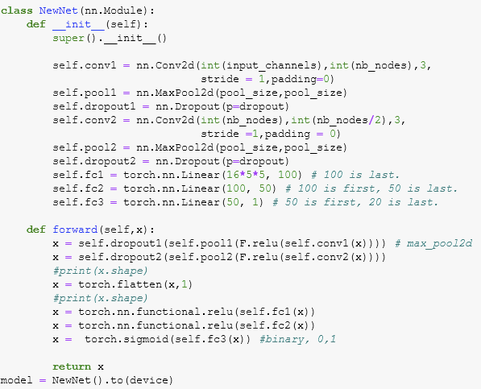
Same normalization
New CNN Architecture
2 Conv2D layers with MaxPool2d layers in between
Dropout layer of 0.25
3 linear layers with ReLu activation functions
32 input nodes, 64 batch size, Adam optimizer with lr .0002, train for 100 epochs

Slide 13
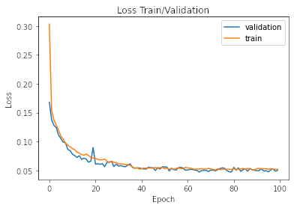
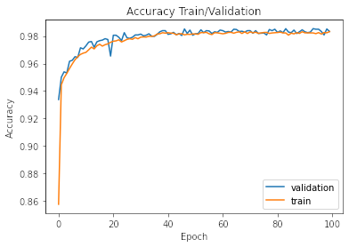
Model Evaluation
Stratified split into train (75%), validation (15%), test (10%), using binary cross entropy loss

Slide 14
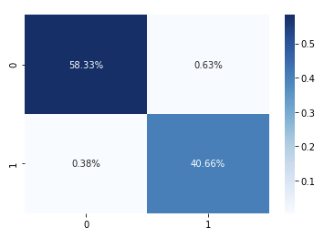
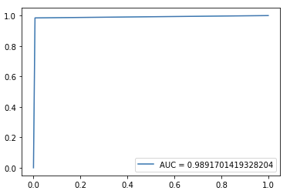
Star: 0, Galaxy: 1
AUC 0.989, test accuracy 0.99, f1 score 0.98

Slide 15
Metric Comparison
Approach #2 slightly outperforms approach #1 in AUC and accuracy!
Approach | Accuracy | F1 | AUC
#1 | 0.987 | 0.98 | 0.985
#2 | 0.99 | 0.98 | 0.987

Slide 16
Asteroid Problem

Slide 17
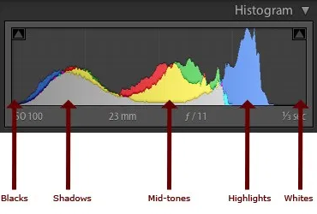
What is image histogram?
It is the tonal distribution in a digital image, it plots the number of pixels for each tonal value.

Slide 18
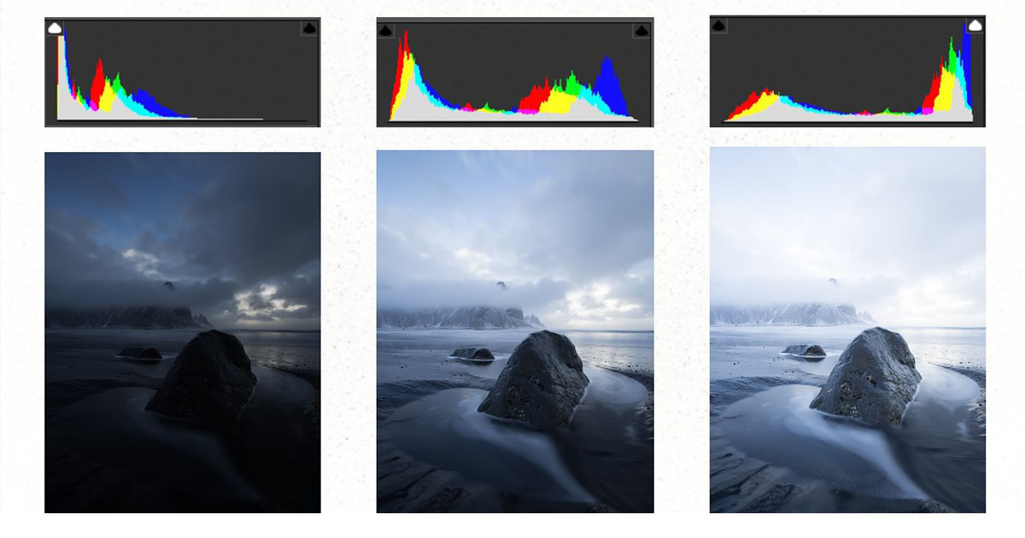

Slide 19
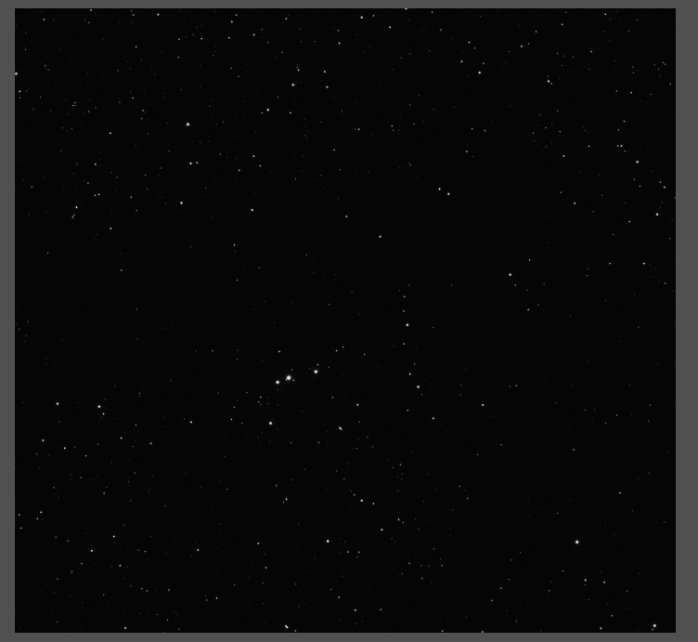
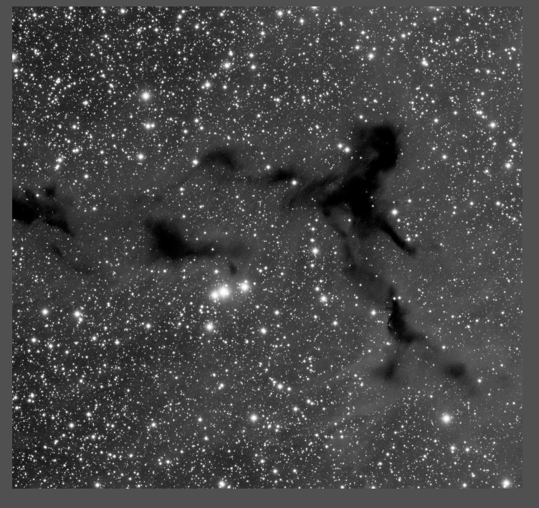
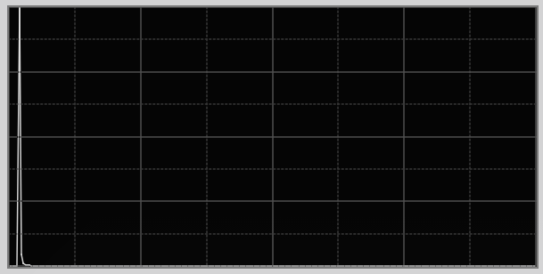
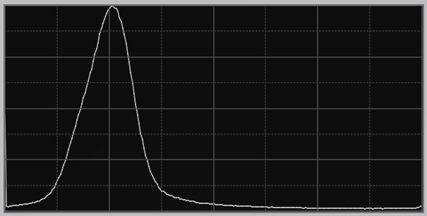
Preprocessing: histogram equalization

Slide 20

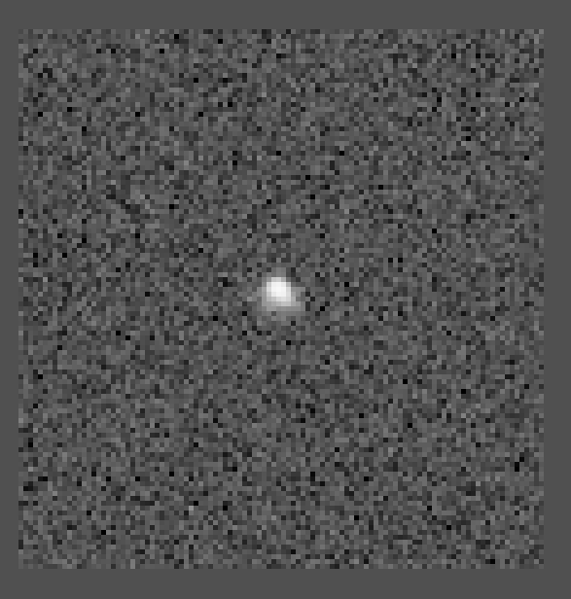

Slide 21
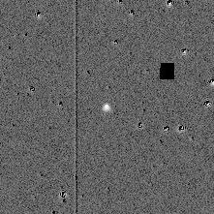
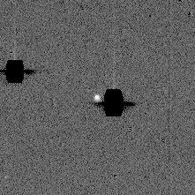
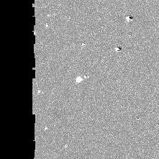
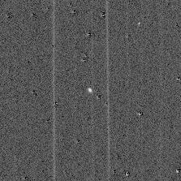
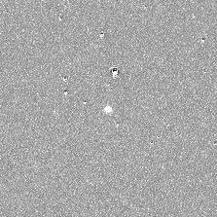
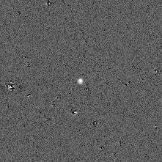
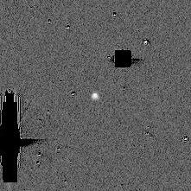
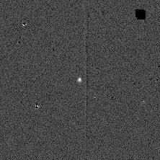
Image cutouts , intentionally to include more background artifacts and defects

Slide 22
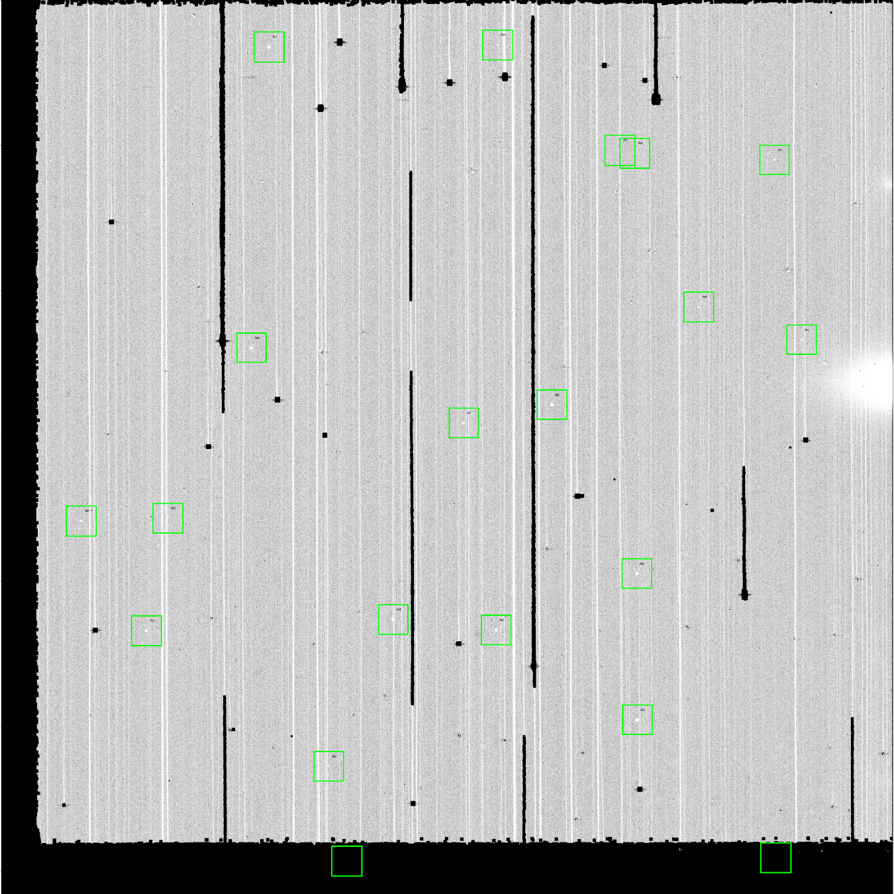
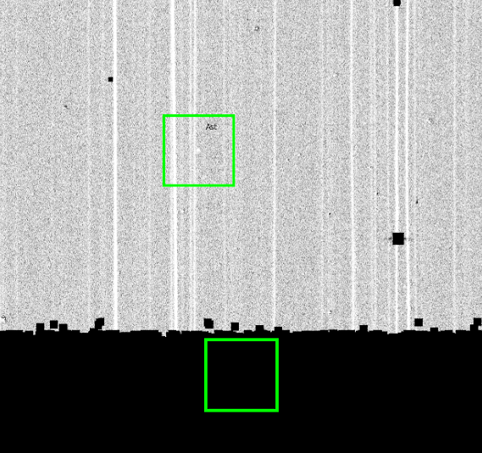
Bad Data Removal:

Slide 23
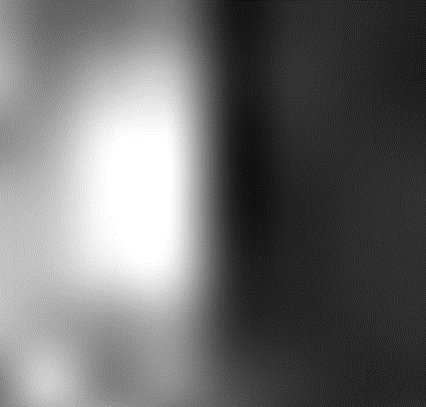
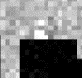
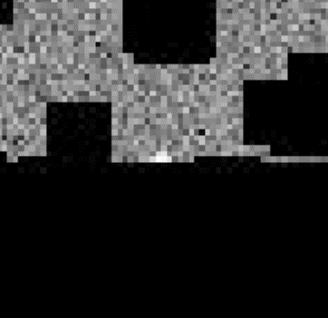
Bad data removal:
Program viewed the center of all asteroid boxes checking is region was greater than a darkness threshold.
If threshold was reached box was discarded from the training set
Example of one asteroid box which was removed

Slide 24
CNN + Sliding Window Approach

Slide 25
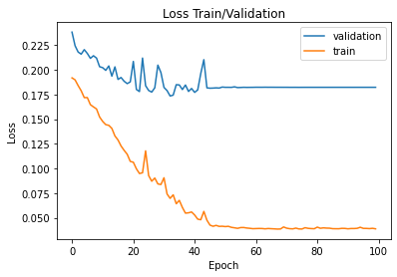
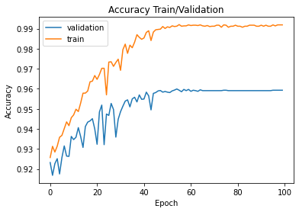
CNN Training/Pipeline
Preprocessed data w/ histogram equalization
Similar architecture as solution #2 to star/galaxy problem
Stratified split into train (75%), validation (15%), test (10%), using binary cross entropy loss
Convergence more difficult with this problem

Slide 26
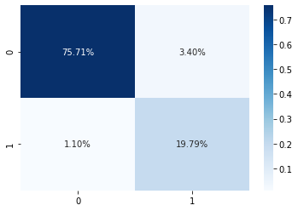
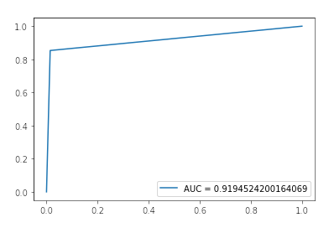
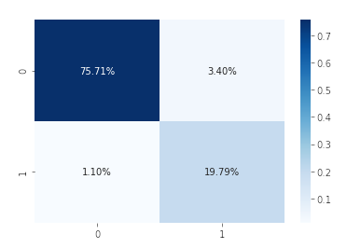
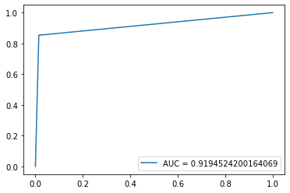
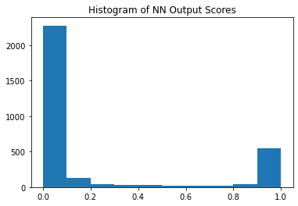
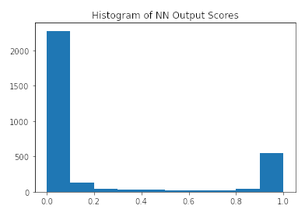
F1 score: 0.898
Accuracy: 0.955
-> relatively good performance training w/ image cutouts!

Slide 27
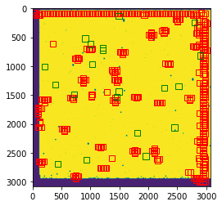
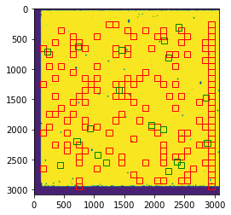
Sliding Window Method
Given window/step size, predict if slices of a given image are asteroids or not
Window size 100, step size 10 Window size 100, step size 100
Asteroid
Predictions

Slide 28
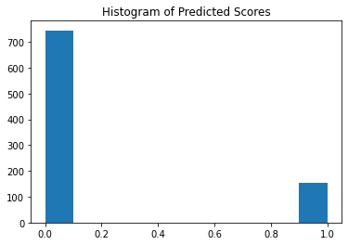
Diagnostics/Potential Improvements
Asteroids only predicted with small windows/step sizes
Location not precise/high misclassification rate
Model very “certain” about asteroids/non asteroids
Improve training data, use pretrained CNN (model may not be well suited to problem)

Slide 29
YOLO

Slide 30
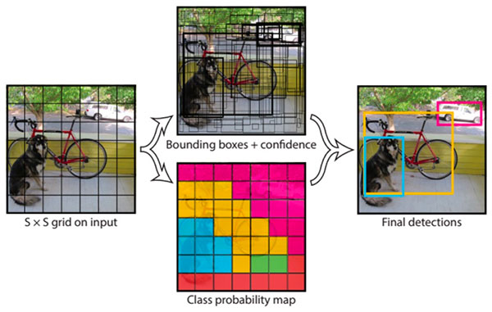
YOLO network (you only look once)

Slide 31
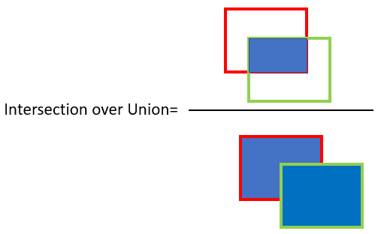


Slide 32


Slide 33


Slide 34

Red : prediction
Green: ground truth

Slide 35




Slide 36


Testing on raw difference image

Slide 37






Slide 38

Faster RCNN:
Uses TorchVision fasterrcnn_resnet50_fpn Detection model
Randomly trained on 100 images 1000 times
Prediction scores less than 30% were discarded

Slide 39

More detail:
;

Slide 40

Early Results:

Slide 41


Final Results:

Slide 42
Conclusions/Further Steps

Slide 43
Star/Galaxy Problem
Asteroid Problem
Good performance with both CNNs, classification seems to be much easier than asteroid problem
CNN + Sliding Window
Good performance training CNN on image cutouts, bad w/ sliding window
Faster RCNN
Good potential, need more training time
YOLO
Best performance

Slide 44
Special thanks
Ryan Dana
Jen Bellig, Nisha Mulakken, Goran Konjevod
Thanks for such a great summer program!
- Team 6 (Ethan, Joe, Elyssa, Andrei)

